Slide 1

IT Services
All IT Staff Conference 3-12-14

Slide 2
Introduction
Why would anybody talk about such a simple concept?
Why would anybody listen?
Because it might not be as simple as we think!

Slide 3
Key Questions
What is a service catalog?
What is a service?
What is a service manager?
What is service management?

Slide 4
Service Catalog
A marketing tool that:
Accurately and simply describes a service.
Effectively represents the relationship between the organization and its community.
Provides clarity and understanding.

Slide 5
Service
  A capability, feature or benefit that:
  Balances competing considerations:
    the needs and interests of the community
    the abilities and resources of the organization
  Is delivered:
    B2B / B2C / C2C

Slide 6
Service Manager
Responsive individual and point of contact:
Authority to implement and evolve
Accountable for value and success

Slide 7
Service Management
Activities and efforts to ensure effective and efficient transactions between three elements:
Delivery
Support
Consumption

Slide 8
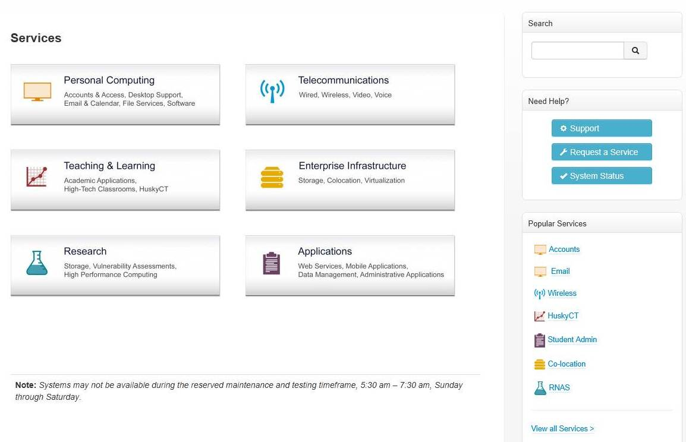
Service Portfolio

Slide 9
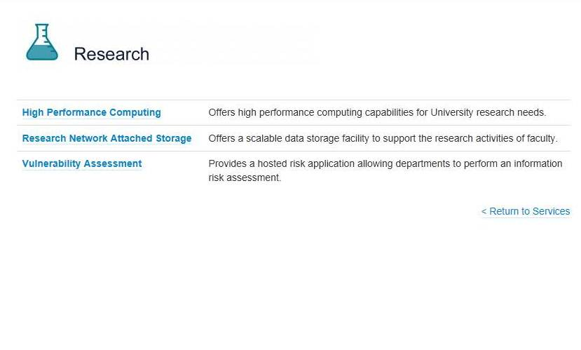
Service Portfolio

Slide 10
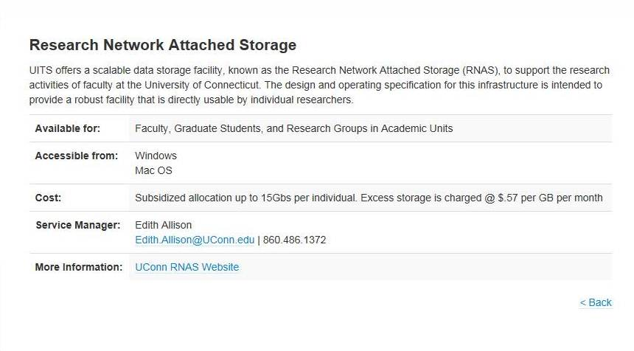
Service Portfolio

Slide 11
Questions
Special thanks to:
  Mindy Carpenter
  Chris Cerrigione
  Kristy Hughes
  Michael Mundrane
  Tim Williams
  And Everyone in UITS who contributed!

