Slide 1
Opening Weekend
HUSKYTECH – UITS

Slide 2
Presenters: rick portuguez & Jonathan Moore

Slide 3
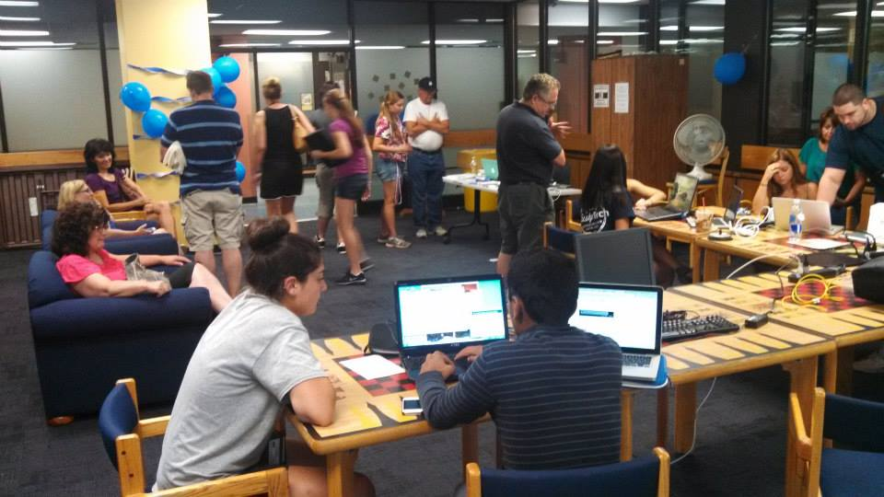
Pictures

Slide 4
Brief history
Responsibilities
Serve the technology needs of all UConn students both on and off campus – including regionals
Assist students with networking and software problems
Help Students set up their digital life at the university
Abstract
Huskytech – Student Tech services
Program offered through student affairs
Founded 20 years ago – ( previously resnet )
Jonathan Moore – Manager
Currently 70 student workers

Slide 5
Opening Weekend Support
Interest in collaboration
SCOPE – 15,000 students moving in – All types of technology
10 locations + Call Center
Fix Minor issues – setting up digital Life concept
Pivotal role for introduction to University life at Uconn
Rewards of collaboration

Slide 6
Successful Collaboration = Preparation
TeCH Support – equipment / transportation
Reslife – reservations / coordination
Information security office – network access / HUskyHUNt
Networking engineering – wired / wireless internet
Helpdesk - accounts
Unified communications – google apps
Server support group – skybox
Applications & tech Solutions – myuconn / huskyct

Slide 7
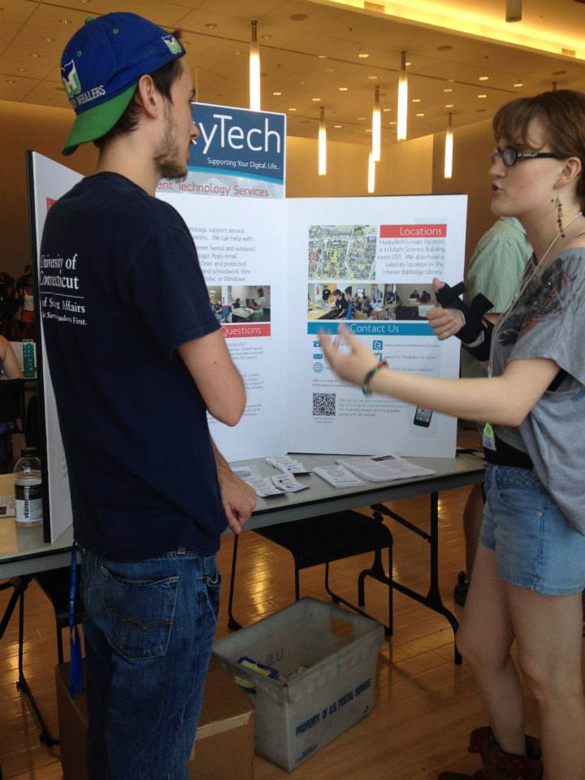
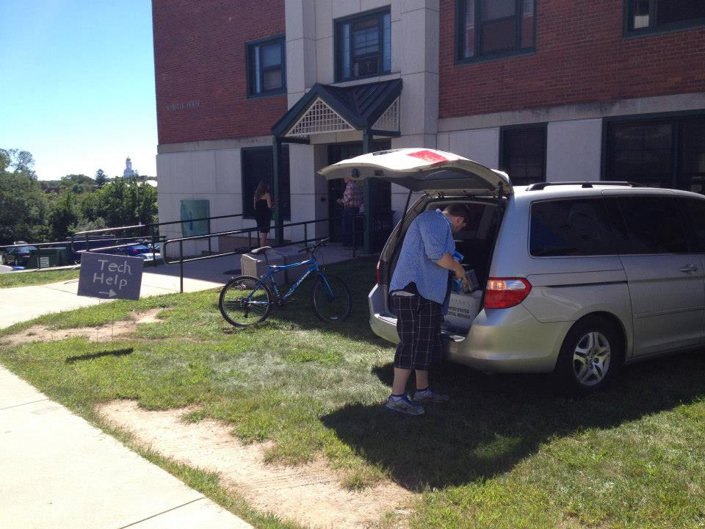
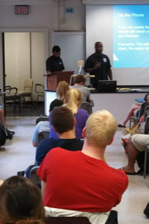
Preparation – 3 months for 3 days
Marketing
Equipment
Training

Slide 8
Implementation – 3 days for 3,000 students
Setup
Workflow
Regroup
Locations
Marketing
Equipment
Training
Staffing
Intake
CSL Setup
Mobile Setup
Office Install
Device Setup
Accounts
Communicate
Problems
Solutions
Supporting Staff
Flexibility

Slide 9
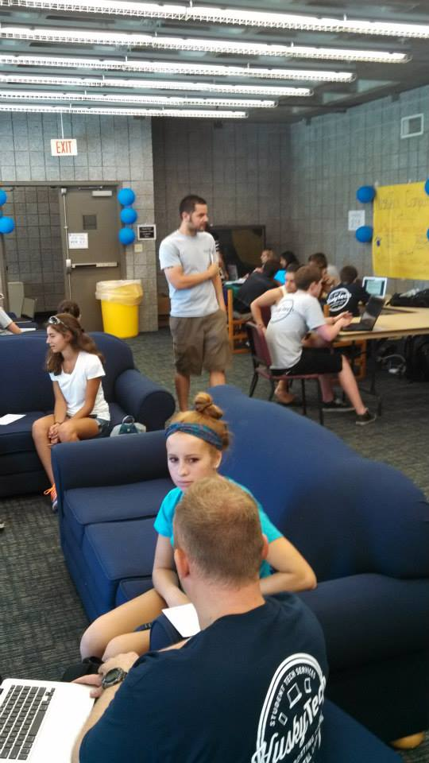
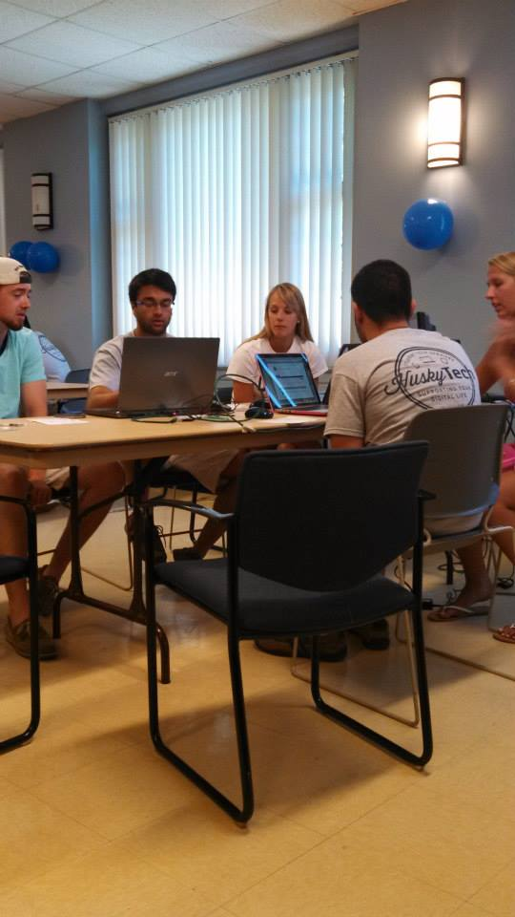
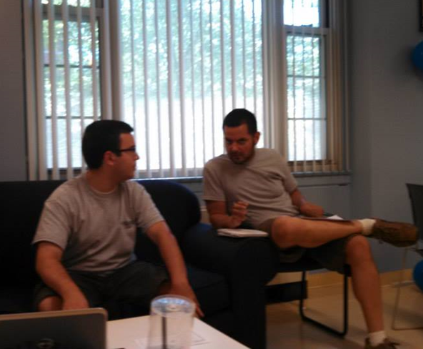
Husky Hunt Pictures

Slide 10
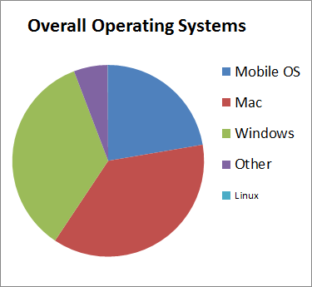
Reflection -
Problems that Arose
Windows 8 with trial Antivirus
Smart Televisions
Wireless printers
Trends
A lot of windows 8
Operating system breakdown
Numbers -

Slide 11
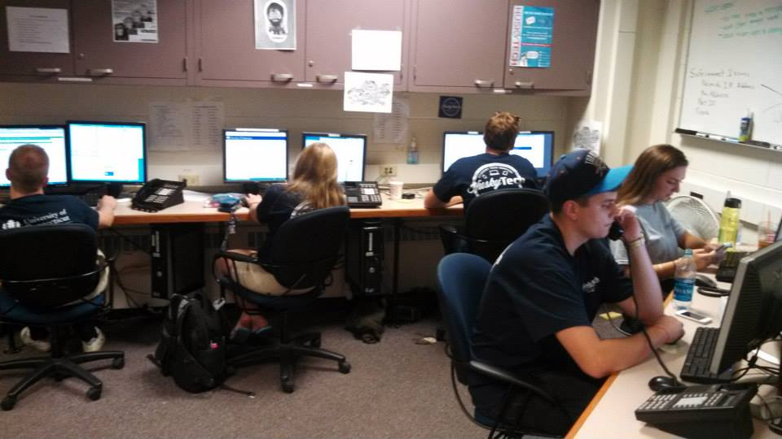
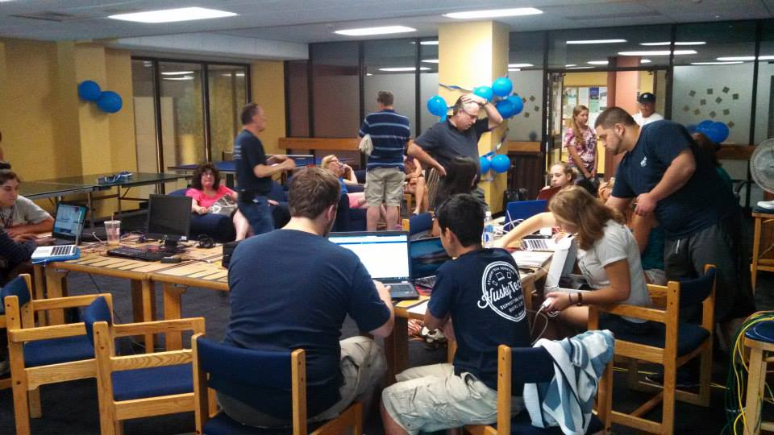
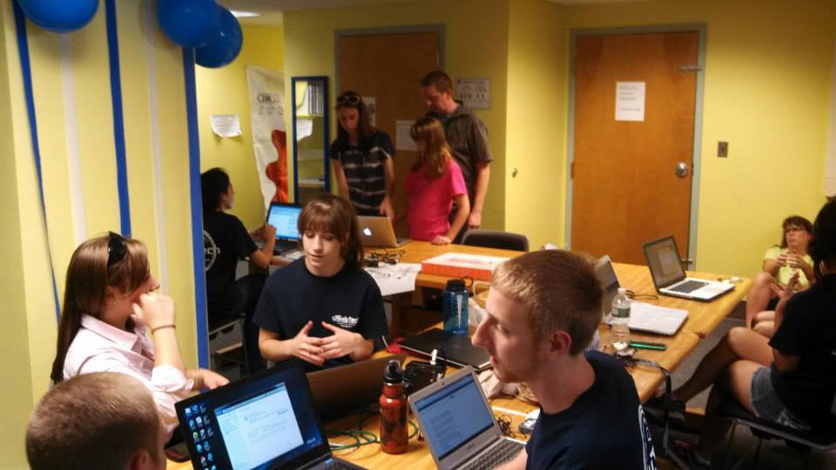
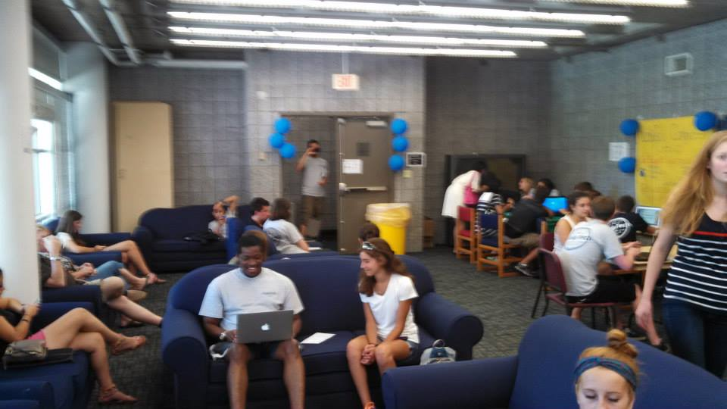
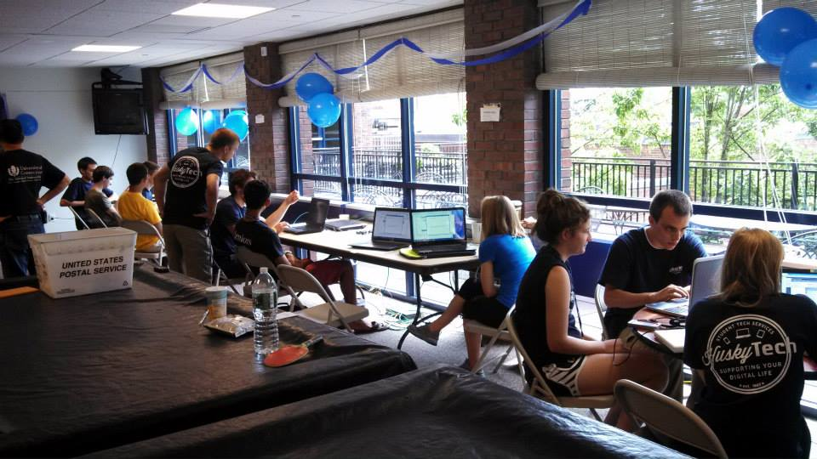
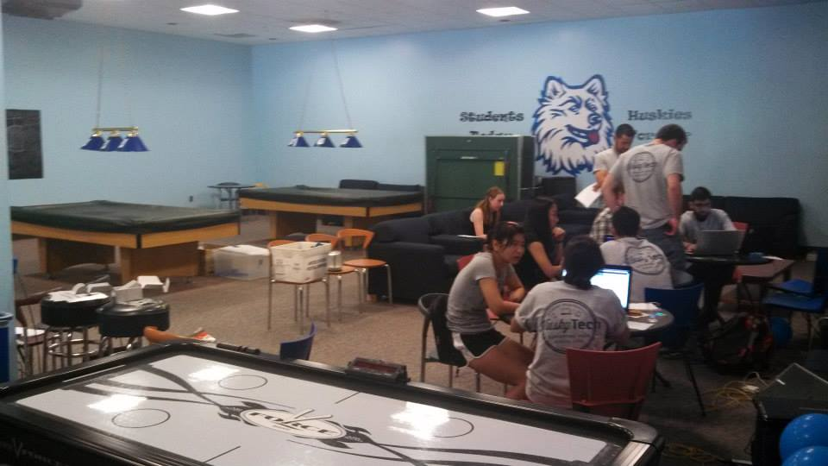
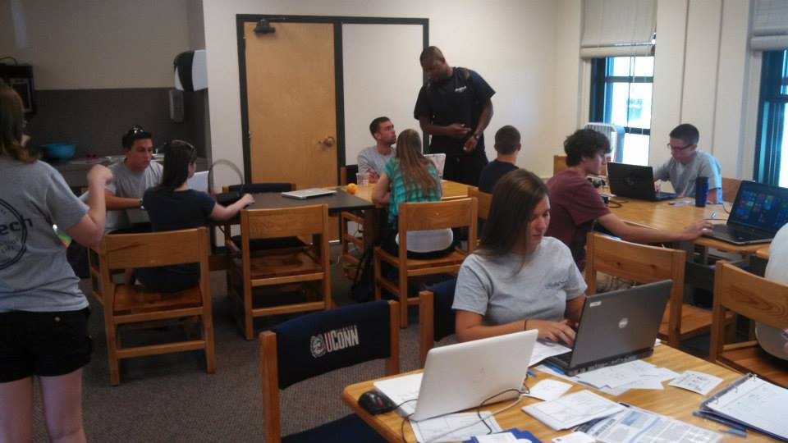
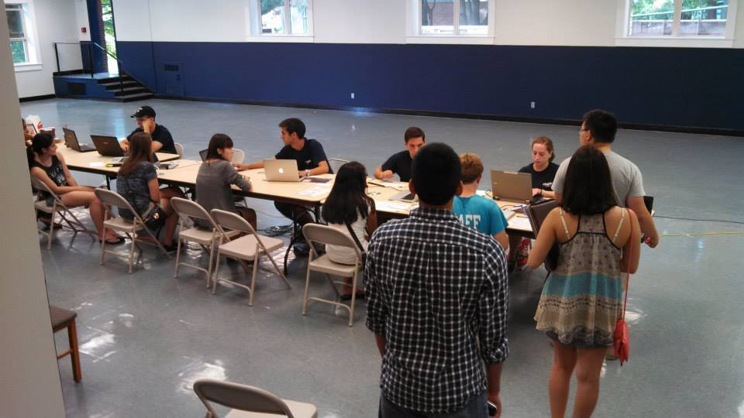
Pictures

