Slide 1
Quality Assurance for Projects
IT All Staff Conference
October 4, 2022
Mick Stevens
IT Quality Assurance
Notes:
Good morning!
My name is Mick Stevens and I work with a great team in the Project Management Office (the PMO). You may have heard of them.
My intention today is to give you a peek into the Quality Assurance piece of the group (as it pertains to our projects). I think everyone can benefit from a better understanding of QA in a project. After all, you'll probably be in one, if you're not already.
When I first started at UConn, 3 questions came to mind about quality assurance. And since then, almost everything I've done has been an attempt to answer those questions. I think you will find it useful. The 3 questions?

Slide 2
Introduction
What is quality assurance?
Why do we need it?
How can we do it better?
Notes:
What is it?
Why do we need it?
How can we do it better?
Actually, the 3rd question use to be… “What’s the best practice?” But as I was searching for that answer, I learned that…
there are no “best practices;” there are only good practices in context. So, “How can we do it better?” is more in line with QA.
I know everyone here has heard of Quality Assurance. But I bet that if I were to ask 10 people what it means, I would get 10 different answers. QA covers a very wide range industries.
So, what is QA?
I usually say that QA is just a fancy name for software tester… but it's a little more than that.
Here's the definition…

Slide 3
What is Quality Assurance?
... an activity that establishes and evaluates the processes that produce products.
Software Testing Body of Knowledge for CSTE Certification
Notes:
Quality Assurance is:
“…an activity that establishes and evaluates the processes that produce products.”
“Products” can be hardware, software, upgrades, or integration projects.

Slide 4
What is Quality Assurance?
… an activity that establishes and evaluates the processes that produce products.
If there is no need for process, there is no role for quality assurance.
Software Testing Body of Knowledge for CSTE Certification
Notes:
It further states…
…If there is no need for process, there is no role for quality assurance.
So, QA also has to do with processes and process improvement.
The concept is, if the processes are good, the outcome will be good.
And testing is a big part of that process.
This is the part everyone sees, and sometimes participates in.
So… What is testing?

Slide 5
What is Testing?
The process of evaluating a product by learning about it through experiencing, exploring, and experimenting, which includes to some degree: questioning, study, modeling, observation & inference, output checking, etc.
Or… What would happen if I did this?
Rapid Software Testing (A Context-Driven Methodology)
James Bach and Michael Bolton
Notes:
What is Testing?
The best definition I've found for testing, although a little long, is from the founders of the Rapid Software Testing (RST) methodology:
Testing is the process of evaluating a product by learning about it through experiencing, exploring, and experimenting, which includes to some degree: questioning, study, modeling, observation & inference, output checking, etc.
The key words are in bold.
But… I like the simpler definition of: What would happen if I did this?
This is where the tester is allowed to investigate and try new things based on the current results of that investigation.
There is no script. This is where you will find brand new, hidden bugs, if there are any.
Some testers will say, If it's not exploratory in nature, it's not testing. I’ve since found that not to be true and I’ll give you an example a little later. (Processes are always evolving.)
So, if you're not testing, what are you doing? … Checking.

Slide 6
What is Checking?
The process of making evaluations by applying algorithmic decision rules to specific observations of a product
Or… Did it do this? Yes or No. (More binary)
Rapid Software Testing (A Context-Driven Methodology)
James Bach and Michael Bolton
Notes:
What is Checking?
Checking is the process of making evaluations by applying algorithmic decision rules to specific observations of a product.
The simple definition: Did it do this? Yes or No. (More binary)
This usually refers to automated scripts that are used for regression testing. You won't find any new bugs, but you will know if something was inadvertently changed by software change somewhere else. It's a good check!
Scripts, scenarios, and test cases are sometimes called checking. We use them all the time, and as long as they are not stifling the tester’s freedom to explore, they're good.
BTW… We've used all of these terms in the past, scripts, scenarios, and test cases, and they all mean essentially the same thing as far as I'm concerned. The differences are not worth arguing about. If the vendor is supplying the scripts, I will generally use whatever name they like, but I prefer scenarios.
In most cases, when I’m conducting a testing session, I will advise the testers to…
vary the data,
look for oddities,
and to explore those things that raise questions. No matter what kind of script we are using.
I'd like to give you an example of testing, checking, and the meaning of quality to different people.

Slide 7
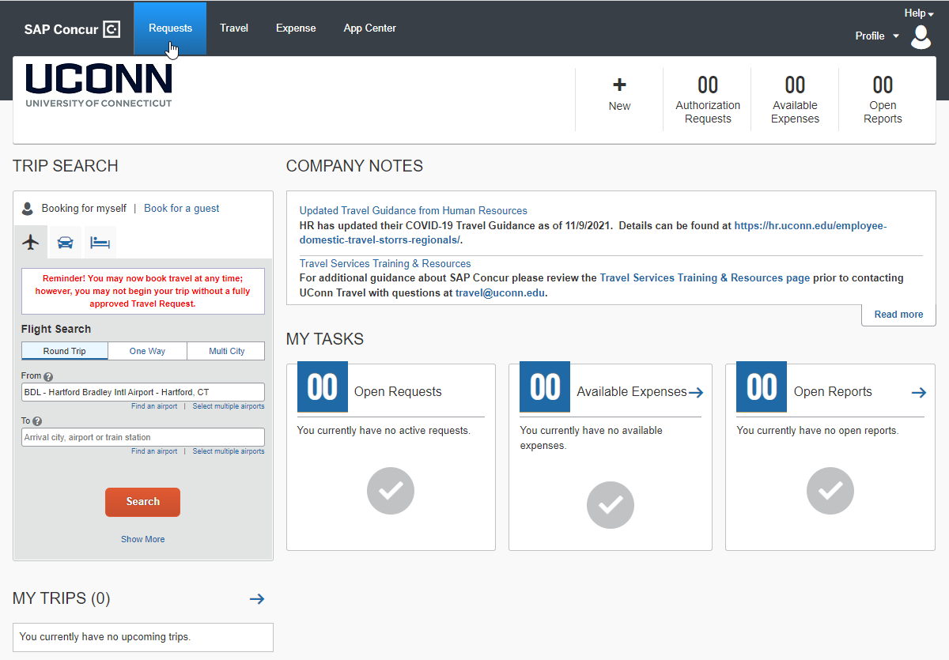
Concur Scenario
Notes:
Some of you might remember the Concur project. This is the home page.
Just a little background for the new people. Concur is a huge SaaS company, that provides travel and expense management services to businesses in (almost) all industries.
UConn bought the 3 modules shown at the top: Requests, Travel, and Expense. The UConn process is to…
First fill out the Travel Request with dates, approx. cost for flights, rental cars, hotels, and food. When that's approved…
Then book your flights, car, hotel.
On return, fill out the Expense report. You could take pictures of all your receipts with the Concur app and they would automatically show up in your account as text so you could add them to your expense report.
It’s a nice process.
So, early on in the project, as I was creating detailed test scenarios, I found what I thought was a bug in Concur’s software.
The scenarios were for checking workflow configuration. So, the testers just completed the scenario. Depending on the scenario they completed, a specific workflow kicked off. (Each one took 15 to 30 minutes.)
The testers were helping by following the different scenarios step-by-step. And the scenarios were serving as a training guide for the testers. It was a win-win. I just want to point out here that the testers are not exploring the software, but they are helping us test.
In order to write detailed scenarios, I had to learn how to use the software. That involved exploring and experimenting with the software so they could be followed by someone who was not yet familiar with the software.. That was testing.
And that was how I found what I thought was a bug.
I had selected a little-known airport from the drop-down list in the Request Module.
I was traveling to Lizard Lick, North Carolina. I was surprised the airport was in the list.
When I went to complete the expense report, in the Expense Module, I could not find that same airport in the drop-down. The user interface also had a different look and feel.
As I explored further (Testing), I saw that these were two completely different lists.
Why would they NOT use the same drop-down list in both modules to avoid confusion and maintain consistency? I mean… consistency is an item I would test for.
Thinking that this was a quality issue, I reported it to Concur through our representative. My thinking was that other companies and universities would have the same concern. To my surprise, Concur was NOT concerned with the issue.
I found they had two separate software teams, working on these two modules. Not surprising, but I was surprising to find that these two teams did not even talk to each other. (They really were separate!) That explained the different look and feel and the different drop-down lists. Weren’t they concerned about the quality of their product? I thought they could at least share their resource lists.
I found out later that the reason they were not so concerned was that most of Concur’s customers use only the Request or the Expense Module, but not both.
We were NOT using Concur the way the majority of their customers use it.
I bring this up just to point out that quality is a fickle thing… it means different things to different people.
I am sure that issue has been fixed or improved by now. They probably just never tested that scenario with Request and Expense together.

Slide 8
Why Do We Need QA?
Project testing
Process improvement
Notes:
Why do we need QA?
2 reasons…
Project Testing – (Self explanatory.) To create test scenarios that will include both the Request and Expense modules together.
Process Improvement - Because, if the processes are good, the outcome will be good.
So yes, processes are important.
We need a process to test all the key aspects of the projects to ensure that everything works as advertised.
We all have a process… or processes we follow. and if it's not written out somewhere, we should at least know what our process is.
The PMO has just created a process for using Teams for projects.
And of course, QA has a process.
Here's the process I strive to follow.

Slide 9
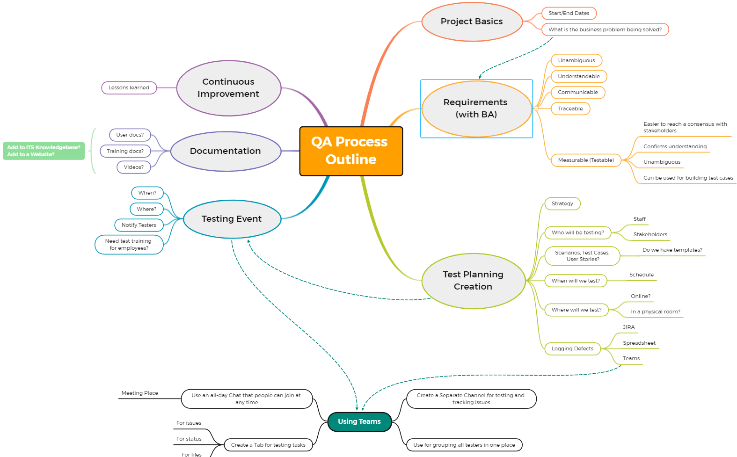
The QA Process
Notes:
(I like using mind maps.)
I know you can’t read all the fine print, so I’ll expand it in a bit.
I just want to point out the flow, from Project Basics…
around in a clockwise direction to Continuous Improvement.
This is not carved in stone… I make changes often, after almost every project… but this is the current process.
The piece on the bottom says Using Teams. I just added that a few months ago and I’m not going to expand on that here.

Slide 10
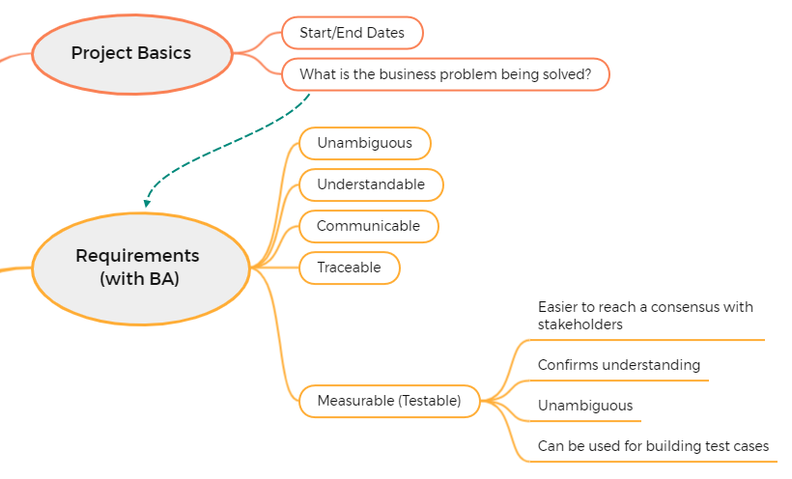
QA Process
Notes:
Here's the upper right quadrant
We start with…
What is the business problem being solved?
I feel like that should be the first thing identified in a new project.
But… sometimes it’s not.
But even if we don't know the real problem to be solved, the requirements process will help to flush that out.
And… I'll work with the Business Analyst to ensure that the requirements are measurable.
If we cannot find a measurement for a requirement, then it is not really a requirement, it's just an idle thought.

Slide 11
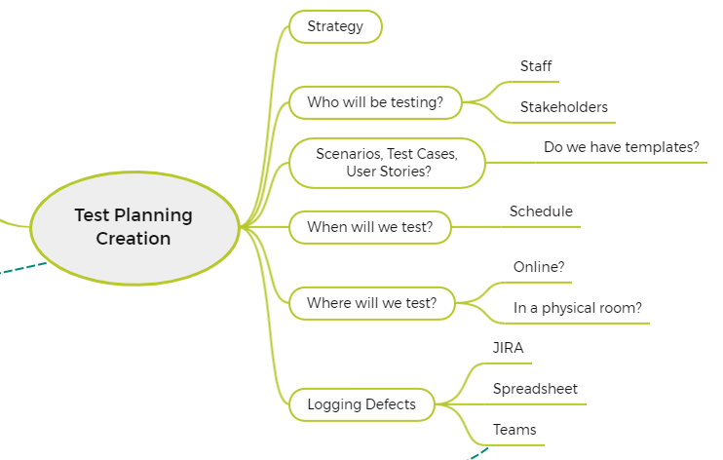
QA Process
Notes:
Here's the lower right quadrant
Here I have things listed so I don't forget about them.
I'll come up with a testing strategy.
Who needs to test?
What kind of scenarios do we need?
Where will we test?
And how are we going to log defects?

Slide 12
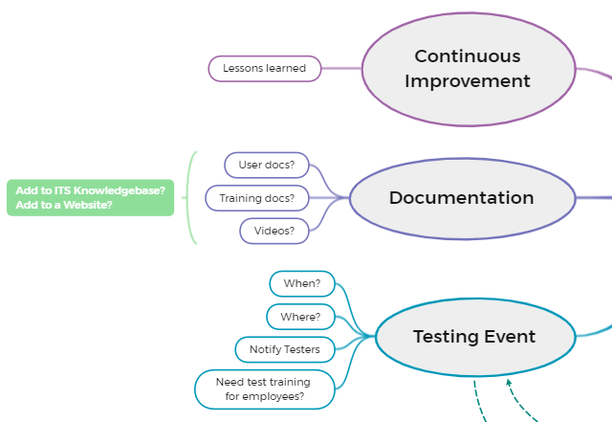
QA Process
Notes:
Then… we step around to the left half
I'll start to think about the testing event.
Where, when, who… How many?
Do the testers need user training before testing?
If so, who's going to do it?
Documentation:
Are there user docs that need to be updated? Or tested?
(Yes, we can test documentation.)
But who will write them?
Are there videos that need to be created or updated?
And of course… Continuous Improvement.
Speaking about the testing event… I just want to mention…
Until Covid came, we used to always hold our testing events in a physical room.
We had 2 classrooms in the Wilbur Cross building, lower level.
Shortly after Covid, we were planning the testing for the KFS Upgrade project. We didn’t know how we were going to do UAT.
I wish I could take the credit, but Brett Paulson came up with the ingenious idea doing it all in Teams. The whole UAT team met every morning to review the new processes, and we kept a chat window open all day so people could jump in with questions at any time.
It worked so well we are still using that process today. We even added a few more bells and whistles.

Slide 13
How Can We Do It better?
Ask the question
Take notice of your processes
Work together
Notes:
The third item on the list was…
How can we do it better?
Ask the question
How can I do this better? This project, this job, whatever it is.
Is there a better way? I believe that if you ask the questions, the answers will come.
Take notice of your processes
Do you even have a process for different aspects of your job?
Work together
Quality is a team effort. There are no islands in the sand here.
I’ve seen it so many times… when a problem crops up in a project, the team gets together and comes up with a solution.
Brett solving the UAT problem that I mentioned earlier.
Everyone contributes.
I remember the first time I heard Catherine (my boss) say that "I was responsible for quality assurance." I think I cringed a little bit. How can I ensure quality for anything? I would prefer the name, Quality Advocate. But I understand the meaning here.
The truth is… no one person can ensure the quality of a project… or even a whole organization. It takes every single person to do that. And I think most of you get that.
And I look forward to working with you all and improving our processes going forward.

Slide 14
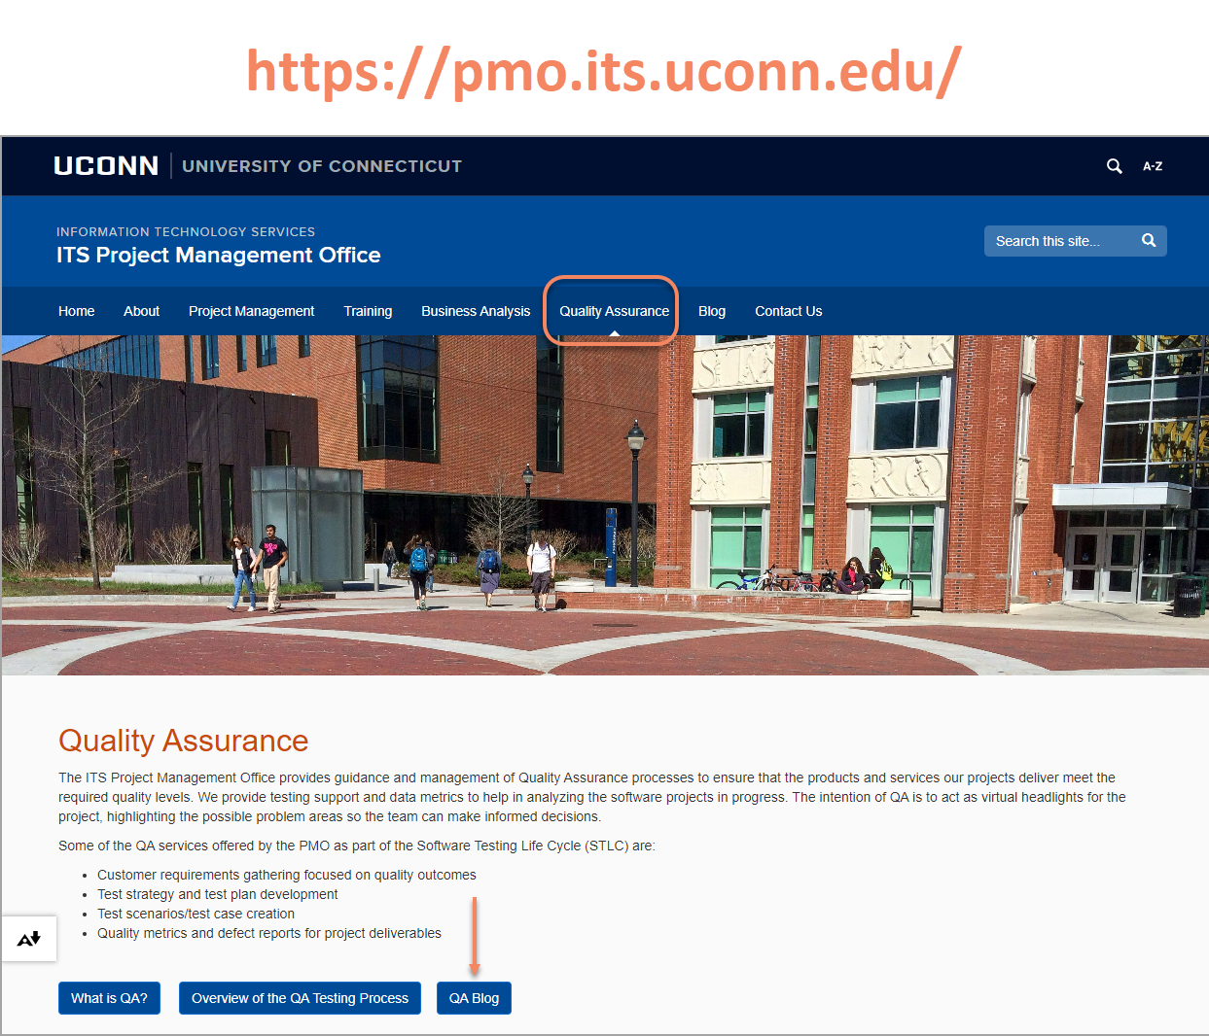
Thank You!
Notes:
So, I’ve given you a lot of the information in this short time and I have only scratched the surface.
You can find much more information about QA (and all the PMO activities) in the PMO website shown here.
The last time I did a similar talk, it was a video talk on QA during Covid. I had so much more I wanted to say back then, that I wrote a series of 4 blog posts just to introduce QA ideas to ITS. They are in the QA section of the site, and I hope you will take some time to read them.
That’s all I got!
Thank you all very much for your kind attention! I really appreciate it!
Are there any questions?

Slide 15
Thank You
Questions?

Slide 16
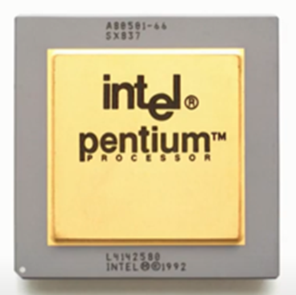
Pentium FPU Bug
May 1994: Flaw discovered and reported internally by a co-op Student working for Intel, Tom Kraljevic.
October 24, 1994: Prof. Thomas Nicely reports the problem from the field to Intel.
November 7, 1994: A Story appears in Electronic Engineering Times, "Intel fixes a Pentium FPU Glitch"
November 21, 1994: Story picked up and broadcast by CNN. Story goes global.
December 20, 1994: Intel recalls all flawed Pentium processors
January 17, 1995: Intel announces a pre-tax charge of $475,000,000 to write-off the microprocessors.
Notes:
Prof. Nicely: A professor of mathematics at Lynchburg College.
A known bug in the floating-point unit of the Intel Pentium P6 processor returns incorrect binary floating-point results when dividing a number.
The bug is caused by five missing entries in a table of approximately 2000 total entries.
Intel's claim: Customer will experience a miscalculation once every 27,000 years.
IBM's claim: Customer will experience a miscalculation once every 9 days.
Byte Magazine's claim: 1/9,000,000,000 random floating-point calculations will result in an error.

Slide 17
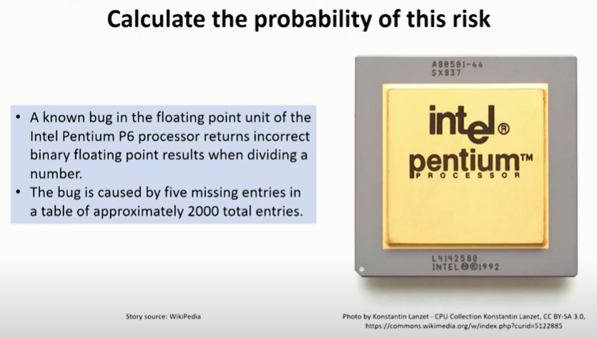
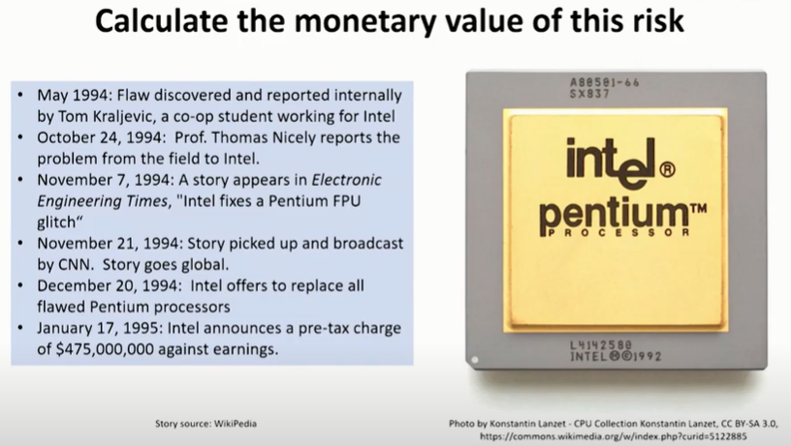
Calculating risk examples

Slide 18
Copyright
Copyright © University of Connecticut Information Technology Services 2018. This work is the intellectual property of the author. Permission is granted for this material to be shared for non-commercial, educational purposes provided that this copyright statement appears on the reproduced materials and notice is given that the copying is by permission of the author. To disseminate otherwise or to republish requires written permission from the author.

