Slide 1
Information and Communication Technology Accessibility
IT All Staff Conference
31 October 2019
Karen Skudlarek and Kathryn Weber-Hottleman

Slide 2
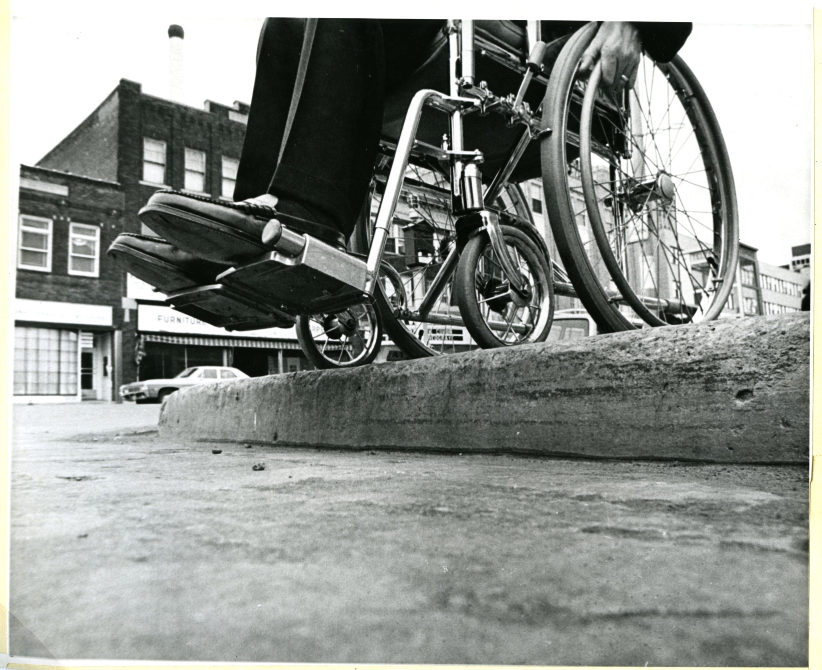
The Curb Effect: 1990s

Slide 3
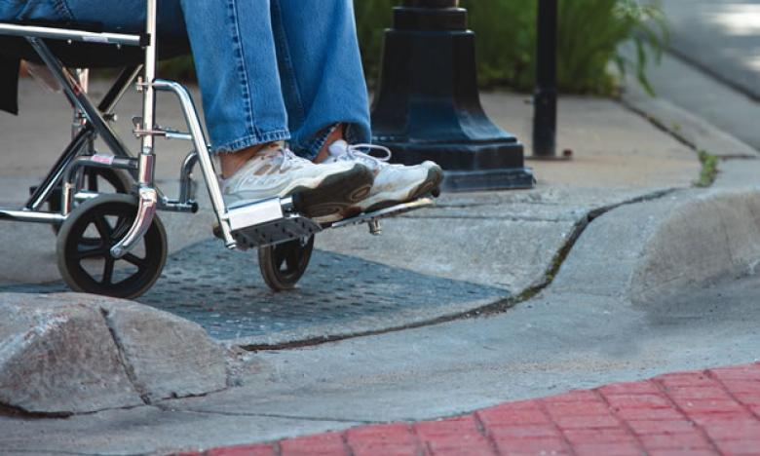
The Curb Effect: 1990s

Slide 4
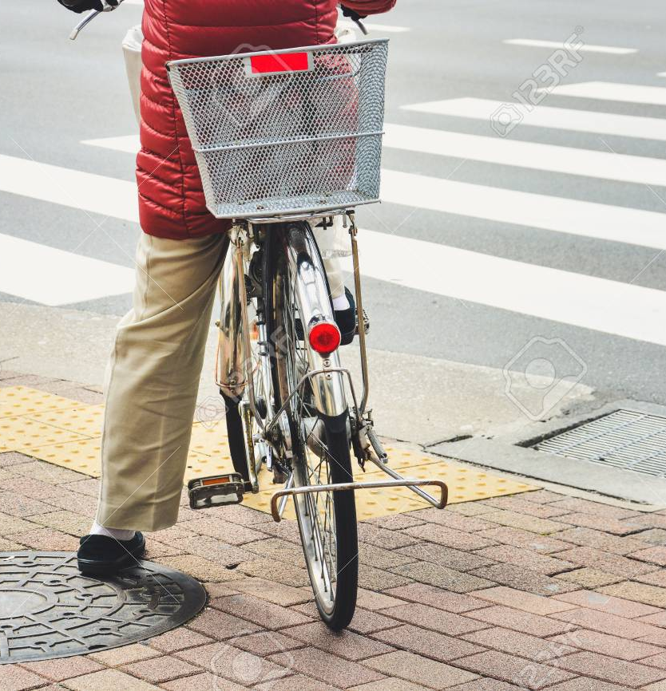
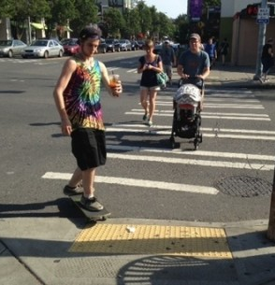
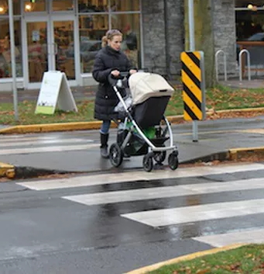
The Curb Effect: Now

Slide 5
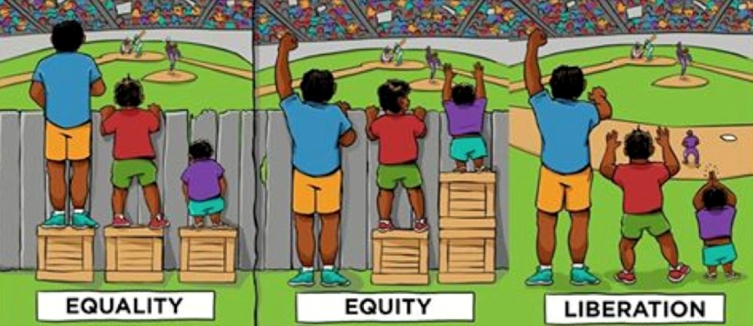
Accessibility vs. Accommodation Example
In this graphic, the left panel represents inaccessibility; the middle panel represents accommodation; and the right panel represents accessibility.
Accessibility is the baseline of equal service, and accommodation is the second step to take when accessibility alone isn’t enough.
Source: https://uiowa.instructure.com/courses/40/pages/accessibility-vs-accommodation

Slide 6
Accessibility at UConn

Slide 7
Background
ICT Accessibility Policy
UConn’s commitment to accessibility
policy.uconn.edu
ICT Accessibility Policy Procedures
accessibility.its.uconn.edu/ict-policy-procedures/
Proactive plan
Evaluating current accessibility levels
Remediating issues
Positioning for future ICT accessibility

Slide 8
Planning and Initiating
Identifying current accessibility issues
Ally for Web
Microsoft Office Accessibility Checker
Remediating issues
Working with different IT teams around campus
Positioning for future ICT accessibility
Creating accessible solutions
Training
Procurement
Notes:
Remediating is on EVERYBODY! Not just on IT groups and Procurement

Slide 9
Training
Average content author
Non-technical
Focuses on quick, easy fixes
Web development and design
Highly technical
Focuses on code and template development
Upcoming: Procurement, Events Management
CETL training available to faculty and staff

Slide 10
Procurement
Why involve accessibility in the procurement process?
Alleviates stress of remediating
Financially responsible
Sensitive to time
Furthers accessibility culture

Slide 11
Carrying Out the Plan

Slide 12
Creating Accessible Content: Captioning
Caption videos and provide transcriptions
YouTube and other machine generated captions are only about 70-80% accurate
Americans with Disabilities Act (ADA) requires that captions are 99% accurate
If you have machine generated captions, you must edit them, otherwise an individual may get the wrong information
Use websites for best practice when captioning, such as the DCMP (Described and Captioned Media Program)
Captioning is critical for those who are deaf or hard of hearing, but it also aids the reading and literacy skills development of many others.

Slide 13
Creating Accessible Content: Document Structure
Screen readers are a form of assistive technology which is essential to people who are blind, visually impaired, or have a learning disability.
To ensure that screen readers are effective some of the things we must do are:
Provide Semantic Structure
Using Styles in Word or PowerPoint or tags in PDFs
Use headings and use them properly
Heading 1 for document title and only have one Heading 1
Heading 2 for all the section titles
Heading 3 for the subsection titles
Notes:
Creating Nonvisually Accessible Documents: https://www.nfb.org/blog/creating-nonvisually-accessible-documents
The National Center on Disability and Access to Education (NCDAE) exists to address issues of technology and disability in education policies and practices to enhance the lives of people with disabilities and their families. www.ncdae.org

Slide 14
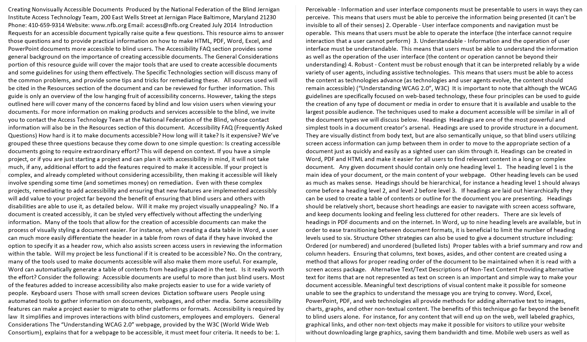
Example of Inaccessible Word Document

Slide 15
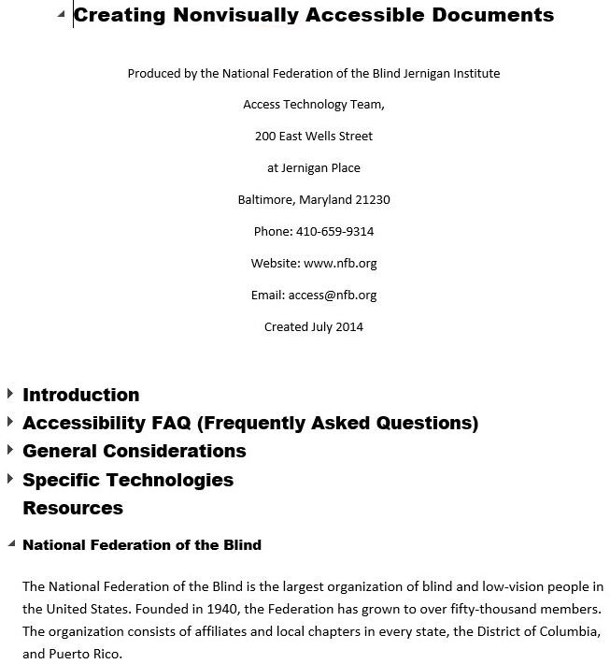
Example of Accessible Word Document

Slide 16
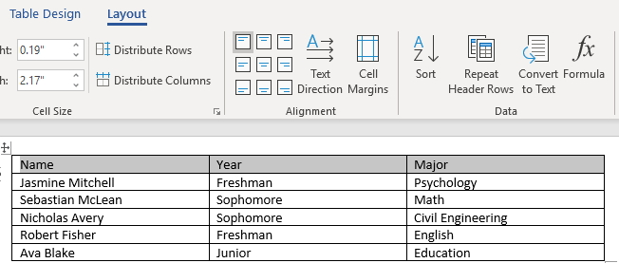
Creating Accessible Content: Document Structure
Other ways to ensure that screen readers are effective:
Use Strong, (not bold) and Emphasis (not italics)
Use true lists, true columns and true tables
Provide text equivalents for all non-text content:
Alt Text
Notes:
Creating Nonvisually Accessible Documents: https://www.nfb.org/blog/creating-nonvisually-accessible-documents
The National Center on Disability and Access to Education (NCDAE) exists to address issues of technology and disability in education policies and practices to enhance the lives of people with disabilities and their families. www.ncdae.org

Slide 17
Takeaways
We are all responsible for ICT accessibility
Central resource for accessibility information: https://accessibility.its.uconn.edu/
Support through ITS, CETL

Slide 18
Thank You
Questions?

Slide 19
Copyright
Copyright © University of Connecticut Information Technology Services 2018. This work is the intellectual property of the author. Permission is granted for this material to be shared for non-commercial, educational purposes provided that this copyright statement appears on the reproduced materials and notice is given that the copying is by permission of the author. To disseminate otherwise or to republish requires written permission from the author.

