Slide 1
Strategic Evolution of Institutional Information Technology
ITS All Staff Conference
2 November 2018
M. Mundrane

Slide 2
Challenges
Dynamic industry.
Increased demand.
Decreased time.
Decreased resources.
… may you live in interesting times.

Slide 3
Strategic Planning
… what it is
Important.
Foundational.
Big picture.
Directional.

Slide 4
Strategic Planning
… what it is not
Urgent.
Narrow.
Immediate.
Arbitrary.

Slide 5
Strategic Planning
What
When
Where
Why
How
Who

Slide 6
Strategic Planning
What
When
Where
Why
How
Who
Tactical.

Slide 7
Strategic Planning
What
When
Where
Why
How
Who
Strategic.

Slide 8
Strategic Planning
What
When
Where
Why
How
Who
Tricky!

Slide 9
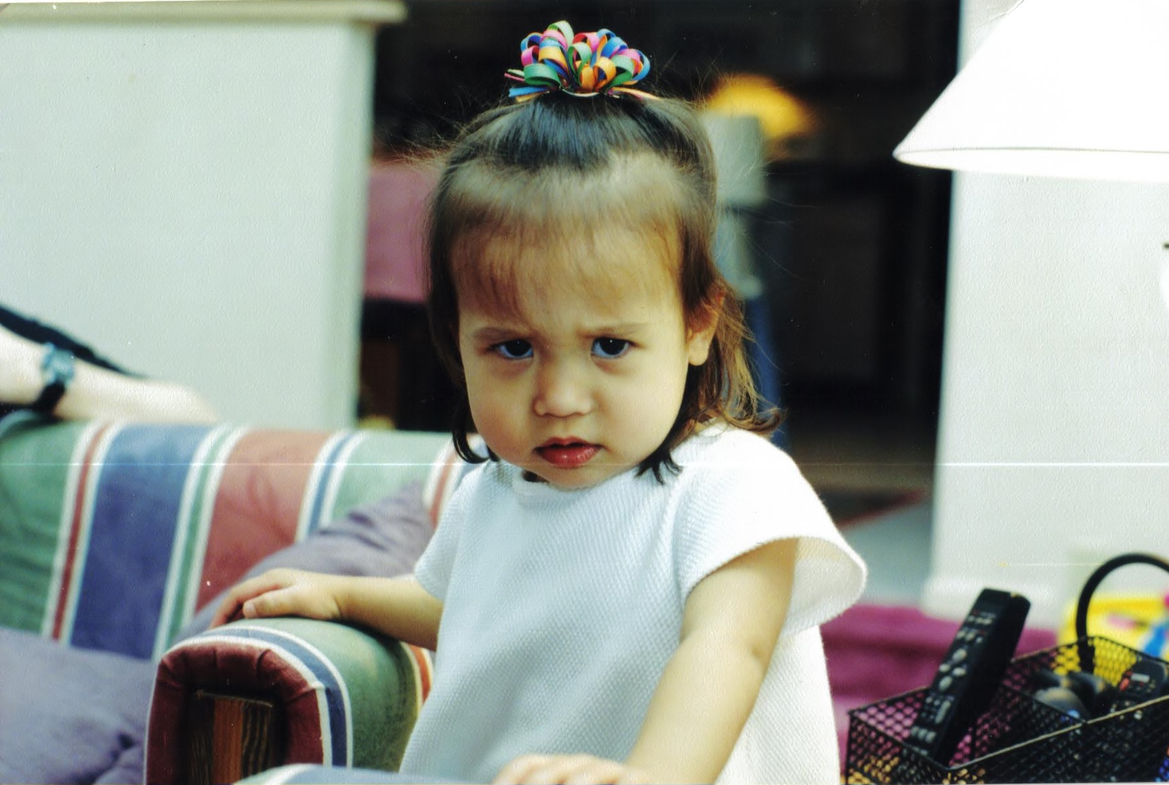
Culture

Slide 10
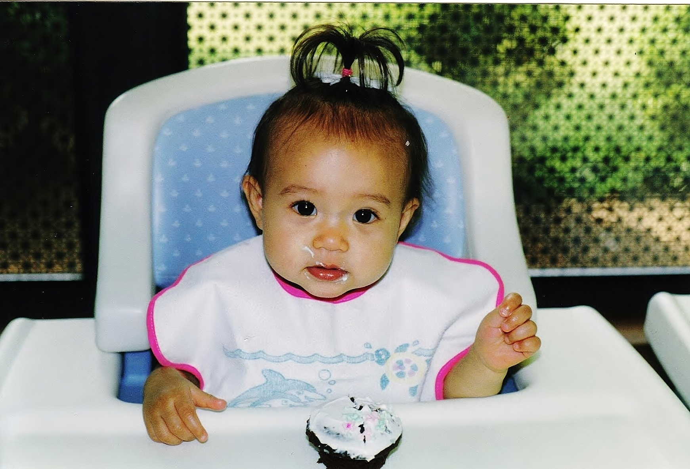
Culture

Slide 11
Culture

Slide 12
Culture
Good Morning

Slide 13
Culture
How are you?

Slide 14
Culture
What time is it?

Slide 15
Culture
The set of rules, conventions, and expectations governing mutual interaction and success. We expect and trust that others will meet these obligations while holding us to do the same.

Slide 16
Culture
Open
Patient
Respectful
Encouraging

Slide 17
Culture
Gracious
Generous
Considerate
Supportive

Slide 18
Culture
Fair
Honest
Sincere

Slide 19
IT Community
Tactical
… we can manage day to day tasks.
Strategic
… we can effectively plan our direction.
Cultural
… who we are as a community profoundly affects our success!

Slide 20
Role of Central IT
Identify those relevant systems, services, and capabilities that can best be performed by the organization and deliver them robustly at scale.
Ensure the success of each and every other IT organization.

Slide 21
Role of IT Professionals
Identify those relevant systems, services, and capabilities that can best be performed by the community and deliver them robustly at scale.
Ensure the success of each and every other IT professional.

Slide 22
Thank You
Questions?

Slide 23
Copyright
Copyright © University of Connecticut Information Technology Services 2018. This work is the intellectual property of the author. Permission is granted for this material to be shared for non-commercial, educational purposes provided that this copyright statement appears on the reproduced materials and notice is given that the copying is by permission of the author. To disseminate otherwise or to republish requires written permission from the author.

